Slide 1
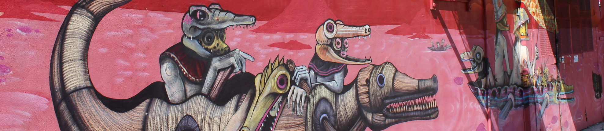

TUTORIAL Applying rigorous machine learning methods in business strategy (Customer Churn)
Mash Zahid
27 February 2019

Slide 2
Mash Zahid
VP, Corporate Strategy & Principal Data Scientist
Highlights | Mash served as senior strategy manager at The Home Depot, where his data-driven approach for improving retail operations and People strategy was detailed in Harvard Business Review's April 2006 cover story. He also served on the M&A teams for HD Supply and an international conglomerate. In recent years, he served as the Associate Partner & head of the ML Practice supporting Microsoft and its major Azure clients. On his own hands-on engagements, he developed automated Inventory Optimization of engine assembly at Subaru Automotive with advanced ML, maintenance recommendations for connected surgical equipment at Stryker, IoT predictive maintenance for all paint mixers at home improvement retail stores, and proprietary trading and valuation algorithms for hedge fund Looking Glass Investments. His core Data Science and Machine Learning experience includes projects at biotech Amgen Digital Health for patient medication adherence & Cardiovascular Clinical Decision Support.
Expertise | Digital Health, Precision Medicine, Patients Disease Identification & Medication Adherence Hedge Fund Trading & Econometrics Machine Learning Models Corporate Strategy & Enterprise Planning at Fortune 15 Companies AI solutions designed & operationalized at leading carmaker & biotech companies, among others Led the Machine Learning Practice for a leading Microsoft Consulting Services Gold Partner focused on Azure Cloud Platform Domain expertise in Biotech, Financial Services, Industrial and Retail
Education | The University of Chicago Booth School of Business - MBA, Analytic Finance & Accounting with Economics PhD work College of Wooster - BA, Mathematics and Political Science
Blogs | How to Build a Scalable Data Science Strategy https://businesstalentgroup.com/blog/how-to-build-a-scalable-data-science-strategy/

Slide 3
TUTORIAL on Applying rigorous machine learning methods in business strategy
This tutorial will provide a hands-on overview of a business strategy project that applies machine learning with a focus on the Python code and common packages, followed by business interpretation of model results and findings.
The presented Python code and process can serve as a useful starting template for typical Data Science projects.
Please message me on Twitter @MashZahid if you would like to receive the Jupyter notebook code & supporting materials afterwards to use freely as a template for your own projects.
As Data Science matures across all companies, there is still a growing opportunity to incorporate advanced machine learning methods inside and by the business functions themselves. Despite massive investments hiring the best data scientists and even more on consulting services, many large companies are not getting the value returns that they expected.
For data-driven projects to create value, the business must ask smart questions, wrangle the relevant data, and uncover fresh insights – this is what classically trained data scientists do well. Understanding what the insights mean for the business and communicating those insights effectively comes from experience, therefore, it is crucial for existing team members across all functions within the organization to explore machine learning methods bravely.
As data-driven culture becomes the default in successful organizations, both executive and business staff will learn to conduct ML experiments by leveraging fundamental statistical knowledge with the usual ML and new AutoML tools.

Slide 4
“It’s only a few lines of code, but it’s a few lines that only a data scientist can write.”

Slide 5
BUSINESS STRATEGY CASE TO BUILD A CUSTOMER CHURN PREDICTIVE MODEL
The strategic objective is identifying a predictive model for customer attrition (i.e., predicting customer churn), which is a direct cost impact to the business and indirect cost to continuing operations.
Exploratory analysis
Feature engineering using RapidMiner, then back to Jupyter
Building baseline classification models in Jupyter
Training & testing the classification models
Improving the models with dimensionality reduction
Operationalizing this model as a *.pkl, then scoring using new data while calling this model output file (H2O saves as a POJO or MOJO)
Compare performance with H2O AutoML run in Jupyter Python, followed by the same entire model development in H2O Flow
Compare performance across
This data science solution involves finding a classification model using historical customer data to predict the probability of churn. This will be a supervised learning problem where we will train a model using past data with labels for customers that have left as well as those who remain.
The value of strategic decisions are enhanced by having better predictions. A good manager asks what is a better (and perhaps, more accurate) prediction worth to business operations.
And with better predictions come more opportunities for growth.

Slide 6
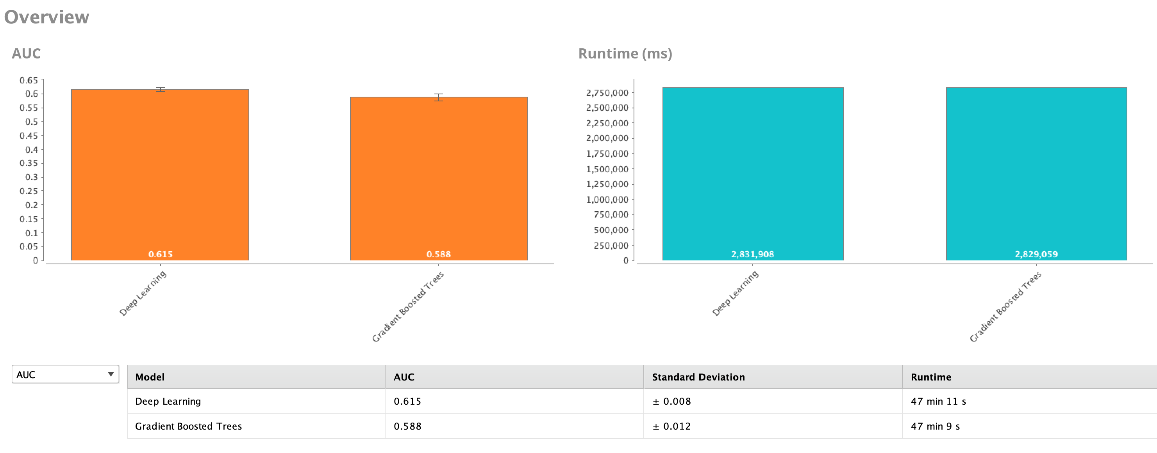

Slide 7
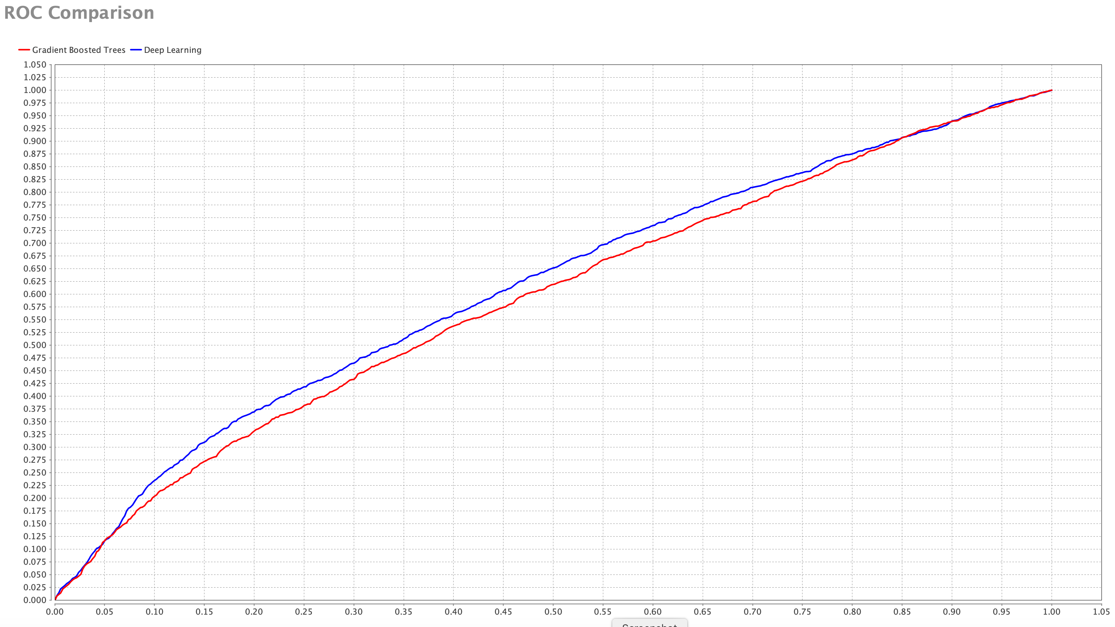

Slide 8
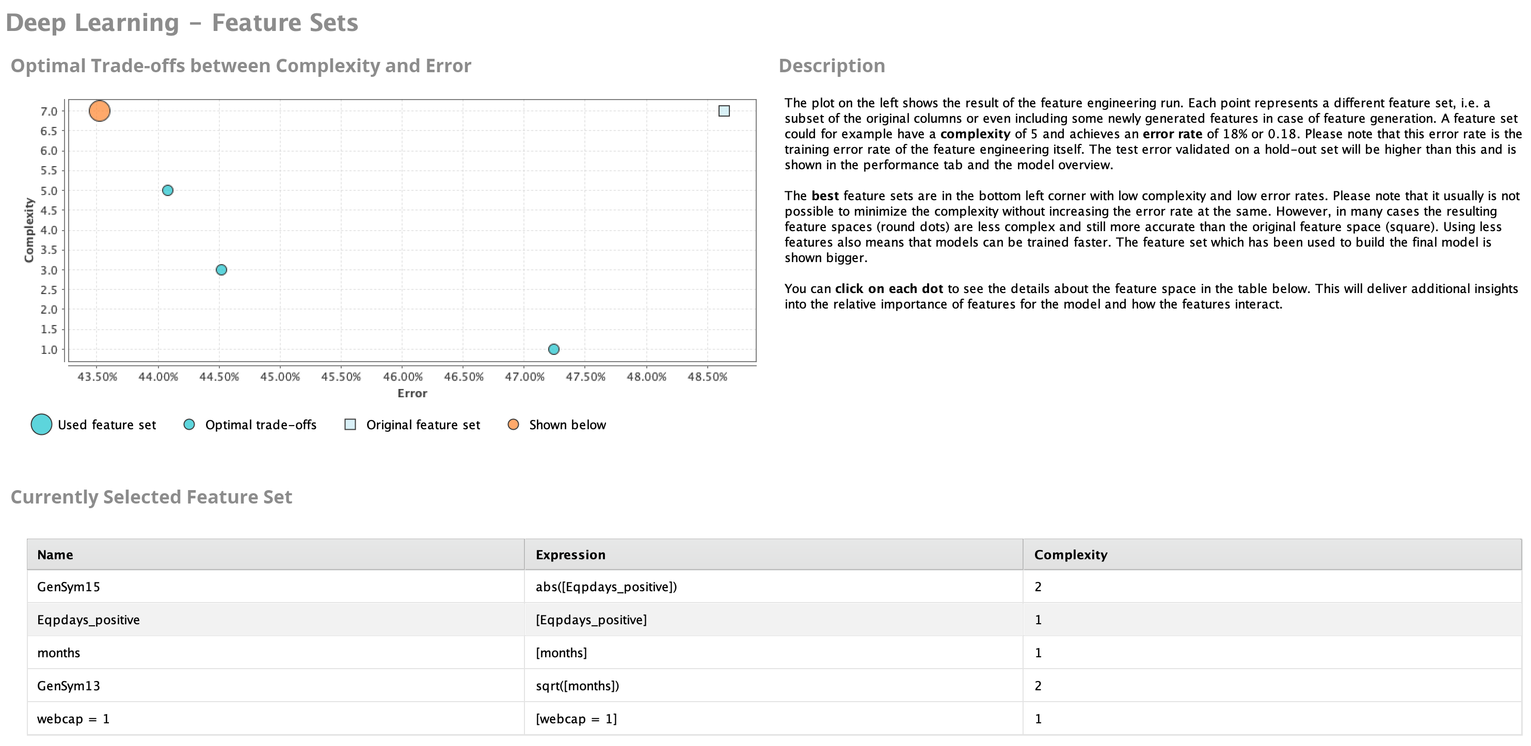

Slide 9
Deep Learning model output
DeepLearning
Model Metrics Type: Binomial
Description: Metrics reported on temporary training frame with 10032 samples
model id: rm-h2o-model-deep_learning-844807
frame id: rm-h2o-frame-deep_learning-212101.temporary.sample.52.26%
MSE: 0.23859778
R^2: 0.0454386
AUC: 0.6223148
logloss: 0.6699554
CM: Confusion Matrix (vertical: actual; across: predicted):
range2 range1 Error Rate
range2 252 4697 0.9491 = 4,697 / 4,949
range1 112 4971 0.0220 = 112 / 5,083
Totals 364 9668 0.4794 = 4,809 / 10,032
Gains/Lift Table (Avg response rate: 50.67 %):
Group Cumulative Data Fraction Lower Threshold Lift Cumulative Lift Response Rate Cumulative Response Rate Capture Rate Cumulative Capture Rate Gain Cumulative Gain
1 0.01006778 0.684487 1.426491 1.426491 0.722772 0.722772 0.014362 0.014362 42.649055 42.649055
2 0.02033493 0.676551 1.398792 1.412505 0.708738 0.715686 0.014362 0.028723 39.879171 41.250535
3 0.03010367 0.675225 1.409741 1.411608 0.714286 0.715232 0.013771 0.042495 40.974115 41.160836
4 0.04066986 0.674253 1.247488 1.368969 0.632075 0.693627 0.013181 0.055676 24.748793 36.896923
5 0.05003987 0.673628 1.259769 1.348521 0.638298 0.683267 0.011804 0.067480 25.976869 34.852132
6 0.10027911 0.668266 1.331422 1.339955 0.674603 0.678926 0.066890 0.134369 33.142220 33.995476
7 0.15011962 0.657780 1.353915 1.344590 0.686000 0.681275 0.067480 0.201849 35.391540 34.458977
8 0.20005981 0.626053 1.280304 1.328542 0.648703 0.673144 0.063939 0.265788 28.030384 32.854231
9 0.30003987 0.555691 1.176705 1.277947 0.596211 0.647508 0.117647 0.383435 17.670518 27.794675
10 0.40001994 0.483464 1.029125 1.215757 0.521436 0.615998 0.102892 0.486327 2.912510 21.575684
11 0.50000000 0.462124 0.977964 1.168208 0.495513 0.591906 0.097777 0.584104 -2.203600 16.820775
12 0.59998006 0.452262 0.940577 1.130276 0.476570 0.572686 0.094039 0.678143 -5.942295 13.027560
13 0.70015949 0.442973 0.942633 1.103428 0.477612 0.559083 0.094432 0.772575 -5.736711 10.342752
14 0.80013955 0.395448 0.838255 1.070293 0.424726 0.542295 0.083809 0.856384 -16.174514 7.029333
15 0.89992026 0.369590 0.749233 1.034695 0.379620 0.524258 0.074759 0.931143 -25.076694 3.469504
16 1.00000000 0.304193 0.688021 1.000000 0.348606 0.506679 0.068857 1.000000 -31.197892 0.000000
Status of Neuron Layers (predicting churndep = 1, 2-class classification, bernoulli distribution, CrossEntropy loss, 2,952 weights/biases, 39.6 KB, 191,350 training samples, mini-batch size 1):
Layer Units Type Dropout L1 L2 Mean Rate Rate RMS Momentum Mean Weight Weight RMS Mean Bias Bias RMS
1 5 Input 0.00 %
2 50 Rectifier 0.00 % 0.000010 0.000000 0.009503 0.006679 0.000000 0.031934 0.145975 0.127842 0.211019
3 50 Rectifier 0.00 % 0.000010 0.000000 0.451175 0.377570 0.000000 -0.094428 0.157879 0.305981 0.256197
4 2 Softmax 0.000010 0.000000 0.018052 0.014888 0.000000 0.042169 0.356445 -0.000000 0.026911
Scoring History:
Timestamp Duration Training Speed Epochs Iterations Samples Training MSE Training R^2 Training LogLoss Training AUC Training Lift Training Classification Error
2019-02-26 17:33:31 0.000 sec 0.00000 0 0.000000 NaN NaN NaN NaN NaN NaN
2019-02-26 17:33:32 0.797 sec 27257 rows/sec 1.00000 1 19135.000000 0.25327 -0.01328 0.70016 0.57826 1.39094 0.49332
2019-02-26 17:33:33 1.486 sec 29191 rows/sec 2.00000 2 38270.000000 0.26291 -0.05182 0.72121 0.61303 1.45230 0.48565
2019-02-26 17:33:33 2.059 sec 31873 rows/sec 3.00000 3 57405.000000 0.24930 0.00261 0.69361 0.58496 1.30335 0.48884
2019-02-26 17:33:34 2.530 sec 34870 rows/sec 4.00000 4 76540.000000 0.24348 0.02593 0.68245 0.61169 1.42649 0.48594
2019-02-26 17:33:34 2.934 sec 37996 rows/sec 5.00000 5 95675.000000 0.24575 0.01682 0.68501 0.61349 1.40695 0.49292
2019-02-26 17:33:35 3.291 sec 41091 rows/sec 6.00000 6 114810.000000 0.23876 0.04481 0.67030 0.62444 1.40695 0.47049
2019-02-26 17:33:35 3.721 sec 44250 rows/sec 7.00000 7 133945.000000 0.24306 0.02758 0.67939 0.62385 1.40695 0.47249
2019-02-26 17:33:36 5.031 sec 38462 rows/sec 8.00000 8 153080.000000 0.23860 0.04544 0.66996 0.62231 1.42649 0.47937
2019-02-26 17:33:37 6.332 sec 34903 rows/sec 9.00000 9 172215.000000 0.24067 0.03715 0.67496 0.61697 1.34833 0.48894
2019-02-26 17:33:38 7.478 sec 33400 rows/sec 10.00000 10 191350.000000 0.23930 0.04262 0.67144 0.61928 1.46557 0.46601
2019-02-26 17:33:39 7.837 sec 33365 rows/sec 10.00000 10 191350.000000 0.23860 0.04544 0.66996 0.62231 1.42649 0.47937
H2O version: 3.8.2.6-rm9.0.0

Slide 10
